Slide 1
Color
By Nicole Dancisin

Slide 2
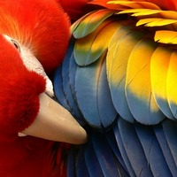
Primary Colors
Red, Blue, and Yellow
Used to create other colors

Slide 3
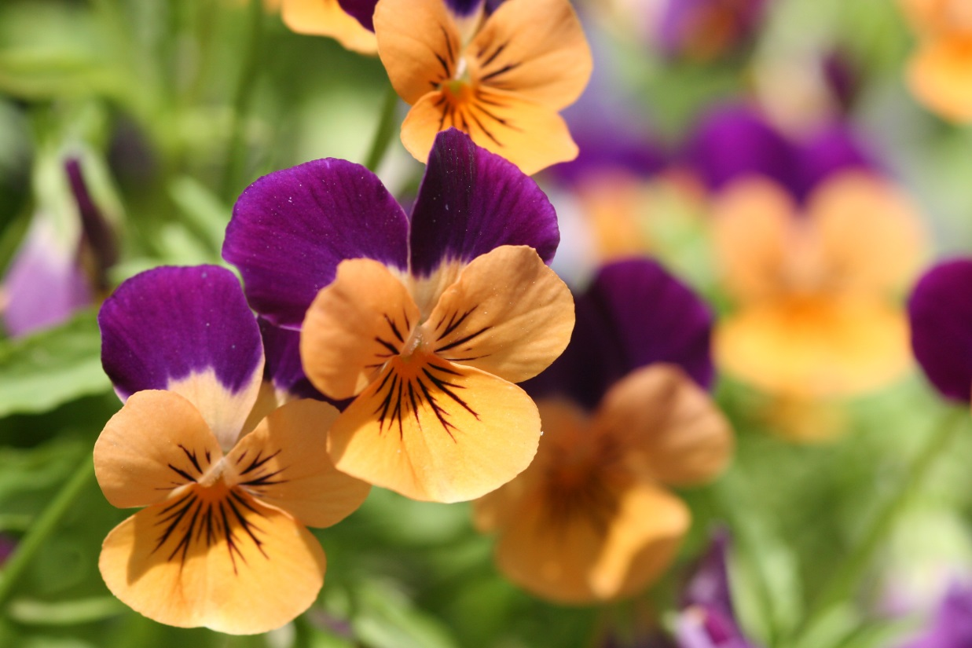
Secondary Colors
Mix two adjacent primary colors evenly
Orange, Purple, and Green

Slide 4
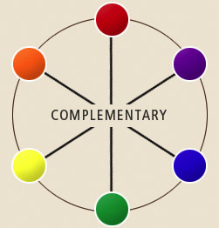

Slide 5
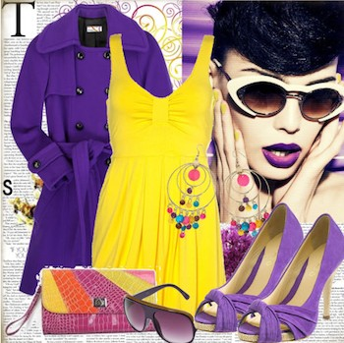
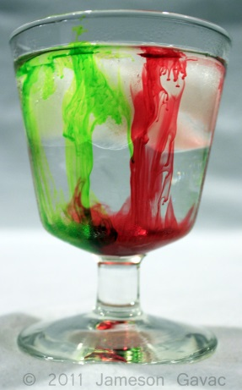

Slide 6
Tertiary Colors
Repeat process of mixing adjacent colors evenly
Blue-green, Orange-yellow, etc.
P
+
S
→
T
S
+
P
→
T
P
+
S
→
T
S
+
P
→
T
P
+
S
→
T
S
P
T
+
→

Slide 7
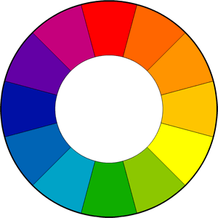
Which leads to...

Slide 8
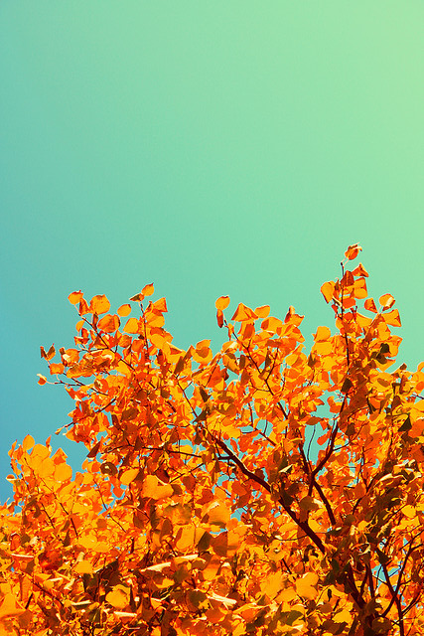
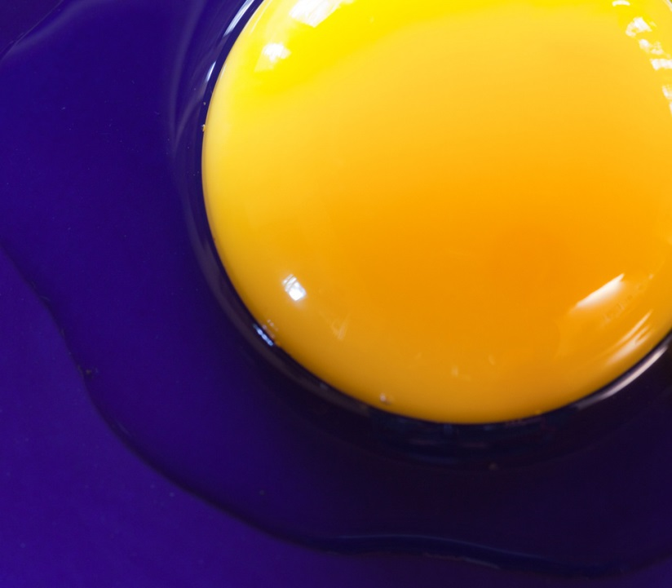

Slide 9
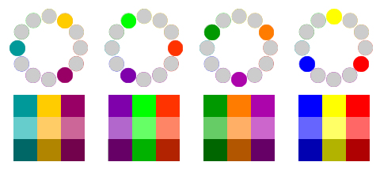
Triad
Three colors that are an equal distance from one another

Slide 10
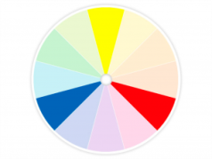
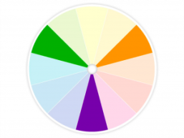
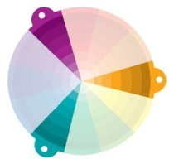

Slide 11
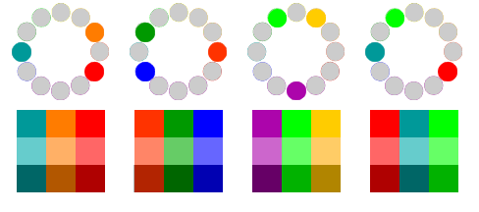
Split Complementary Triad
Choose a color and find its complement. The complement is your first color.
Then, go back to the former color, and your remaining two colors of the triad are those found alongside it.

Slide 12
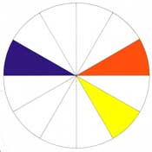
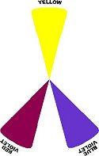

Slide 13
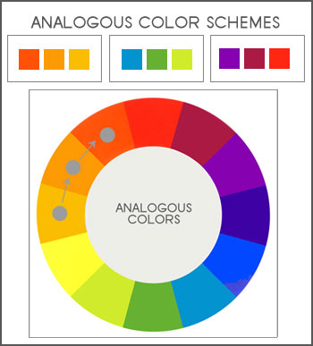
Analogous
Two to six colors next to each other on the color wheel

Slide 14
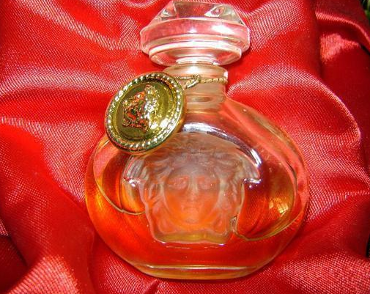
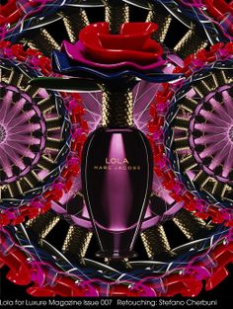

Slide 15
Shades and Tints
Hue: Pure Color
Shade: Add black to a hue
Tint: Add white to a hue

Slide 16
Shades and Tints (cont.)
Monochromatic Colors: One hue with any number of color combinations of its tints and shades.

Slide 17
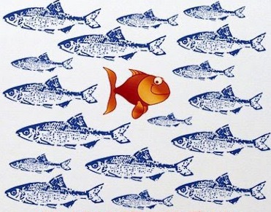
Go Against the Grain
Don’t let culture and its influences limit you.

Slide 18
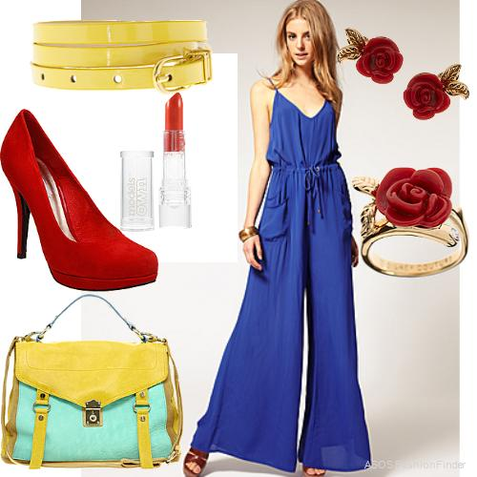
The Primary Triad is Not Limited to Kids Toys
VS.

Slide 19
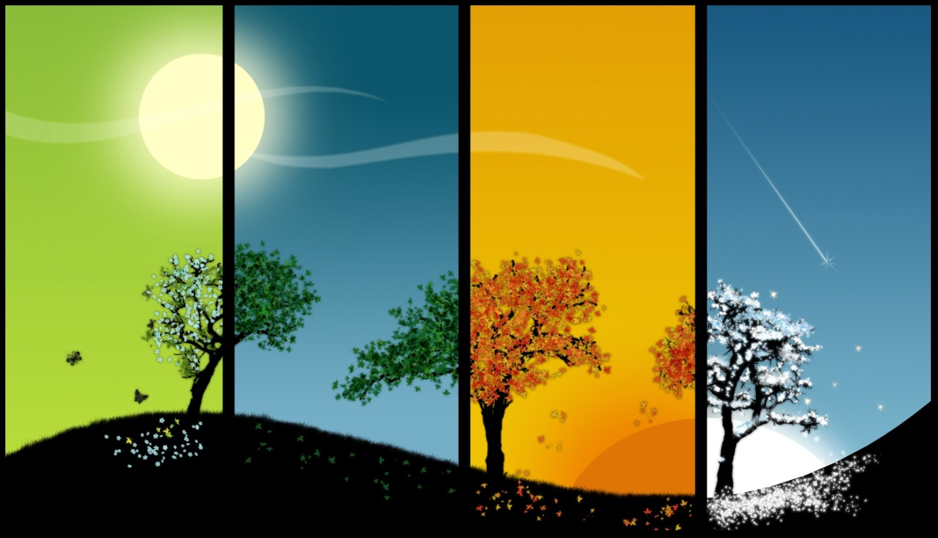
The Four Seasons

Slide 20
Summer

Slide 21
Summer (cont.)

Slide 22
Winter

Slide 23
Winter – Holiday Colors

Slide 25
Spring

Slide 27
Spring (cont.)

Slide 28
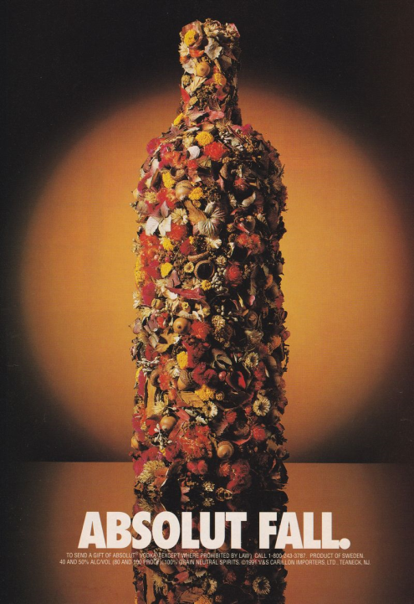
Autumn

Slide 29
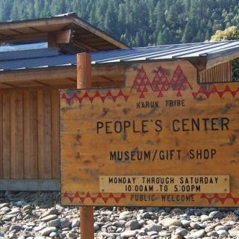

Slide 30
END

